Slide 1

Visitor Management System
Event-Driven Microservices Architecture
Built with Play Framework, Scala, Akka & Kafka
Prepared by: Onkar Vallal

Slide 2




The Challenge
Business Requirements
Modern corporate offices require intelligent automation for visitor lifecycle management—from entry through exit. The system must seamlessly coordinate between reception staff, host employees, IT support, and security teams while maintaining real-time communication and complete audit trails for compliance and safety.
Check-In/Out
Data Capture
Automated visitor registration and departure tracking with timestamp precision
Visitor details, host information, ID proof verification, and visit purpose documentation
Smart Alerts
Modern Stack
Real-time notifications to host, IT, and security teams across all channels
Play Framework, Akka, Kafka, and Docker for enterprise-grade scalability

Slide 3

Event-Driven Solution Architecture
1
Play Framework Backend
RESTful API for check-in/check-out operations
Persistent storage of visitor and visit-log data
Secure ID proof upload and reference management
Event publishing to Kafka topic visitor_notifications
2
Akka Microservice
Kafka message consumer with actor-based processing
ServiceCoordinatorActor orchestrates message routing
Specialized actors: HostEmployee, ITSupport, Security
Email delivery and comprehensive activity logging
3
Kafka Event Bus
Decouples services for independent scaling
Ensures reliable, asynchronous messaging
Guarantees event delivery and ordering
4
Data Layer
Slick DAOs manage relational entities
Tables: Visitors, Employees, Departments, VisitLogs
Type-safe database queries and transactions

Slide 4
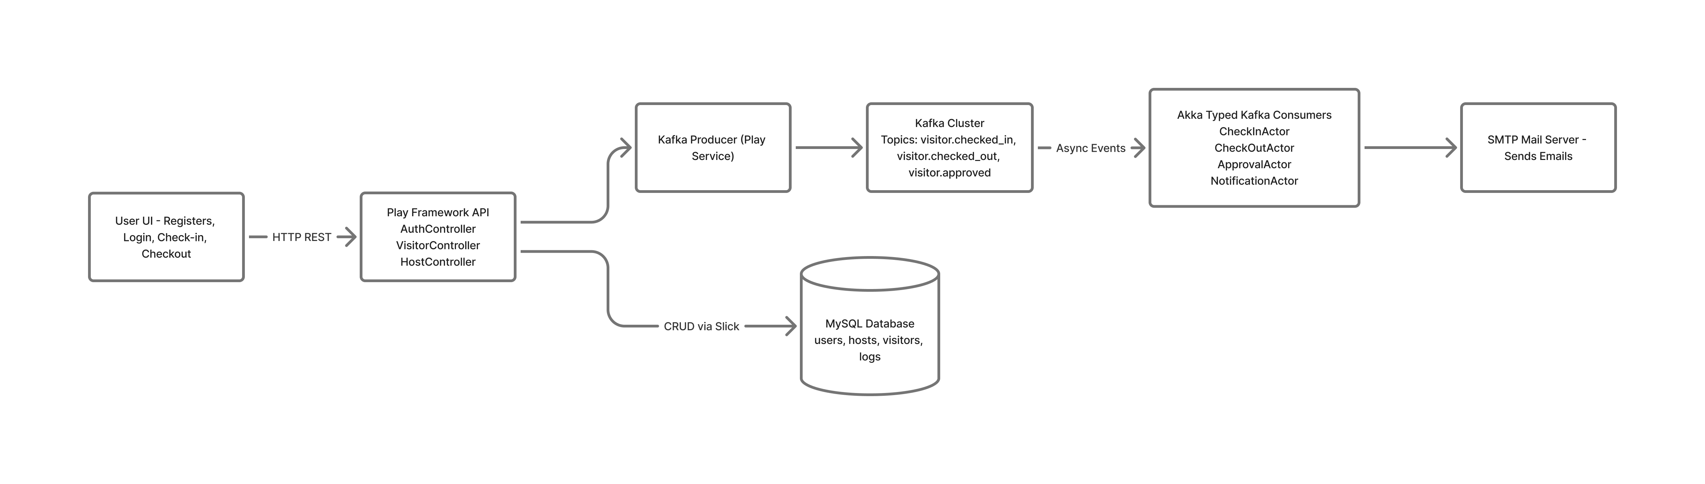
Architecture

Slide 5
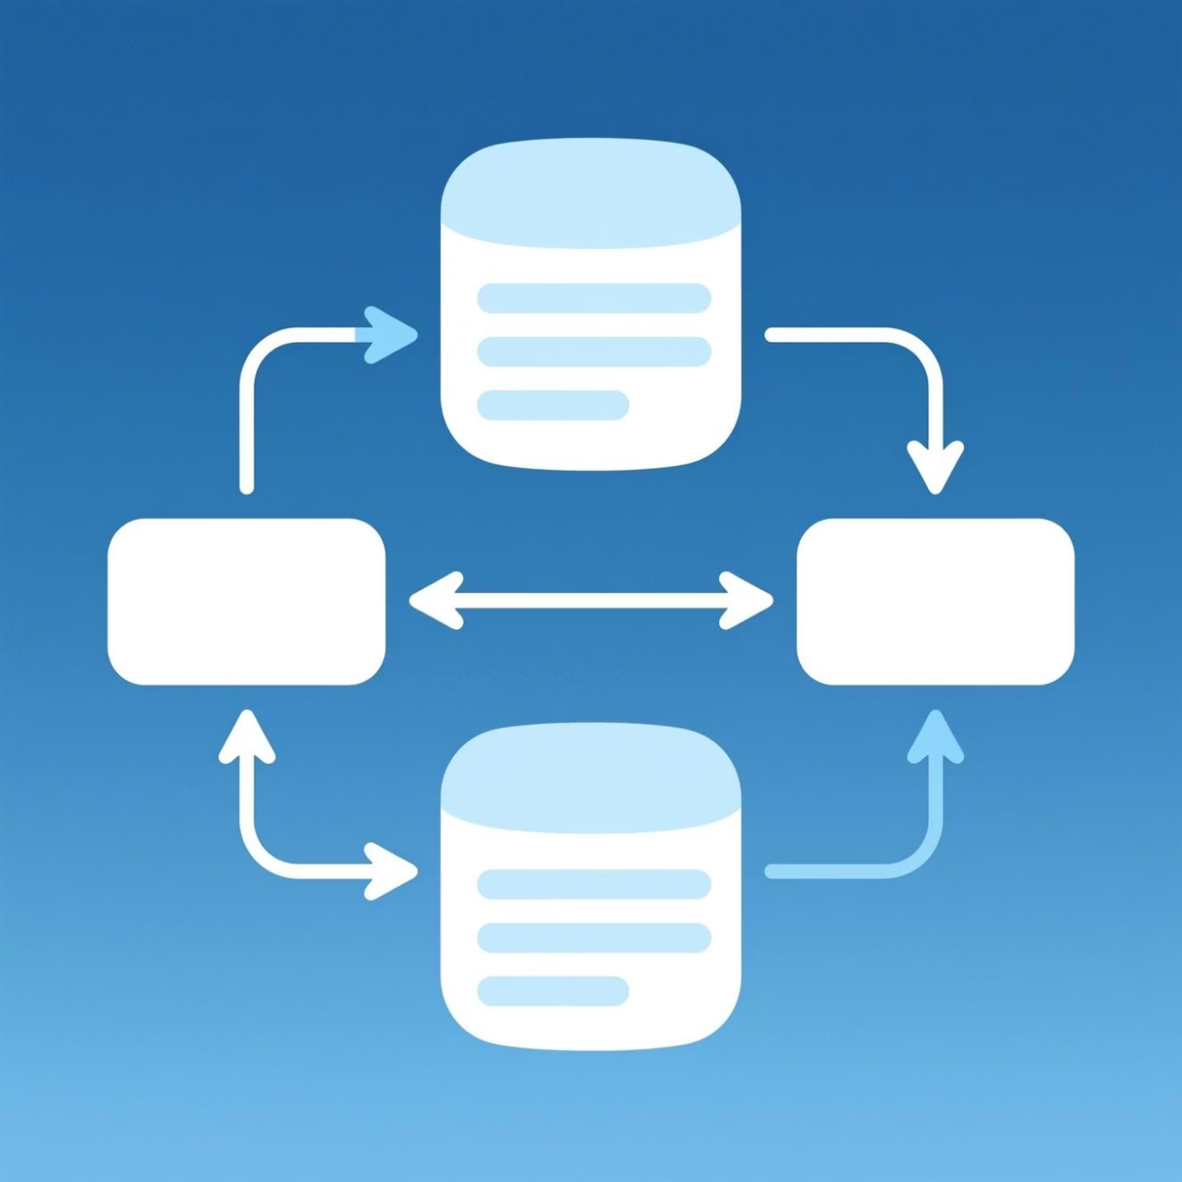
Implementation Flow Overview
Check-In Flow
Reception triggers /checkIn endpoint → VisitorController persists Visitor and VisitLog entities → ID proof uploaded and URL stored → KafkaProducerService builds JSON event → Message published to visitor_notifications topic
Message Processing
KafkaVisitorConsumer listens for incoming events → Parsed JSON sent to ServiceCoordinatorActor → Coordinator intelligently routes to specialized actors → EmailHelper sends notifications to stakeholders
Check-Out Flow
/checkout endpoint updates VisitLog status → CHECK_OUT event published to Kafka → Akka actors process exit notifications → Activity logged and notification workflows stopped

Slide 6




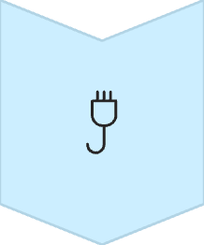

Check-In Sequence
The check-in process demonstrates the power of event-driven architecture through seamless coordination between multiple services and actors.
Reception Initiates
Staff submits visitor details via web interface with complete information
Play App Processes
Controller validates data, persists to database, uploads ID proof securely
Event Published
CHECK_IN message sent to Kafka topic with full visitor context
Akka Consumer Receives
KafkaVisitorConsumer picks up message and deserializes JSON payload
Coordinator Routes
ServiceCoordinatorActor distributes to HostEmployee, IT, and Security actors
Notifications Sent
EmailHelper delivers customized alerts to all stakeholders instantly

Slide 7

Check-Out Sequence
01
02
03
Exit Registration
Status Update
Event Broadcast
Reception staff triggers /checkout endpoint with visitor ID
Play service updates VisitLog with check-out timestamp and status
CHECK_OUT event published to Kafka with complete exit details
04
05
Actor Processing
Workflow Completion
Akka actors receive message and trigger exit notifications
Exit alerts sent to relevant parties, notification flows terminated
Key Benefit: The system automatically stops all active notifications when a visitor checks out, preventing unnecessary alerts and ensuring clean state management throughout the visitor lifecycle.

Slide 8
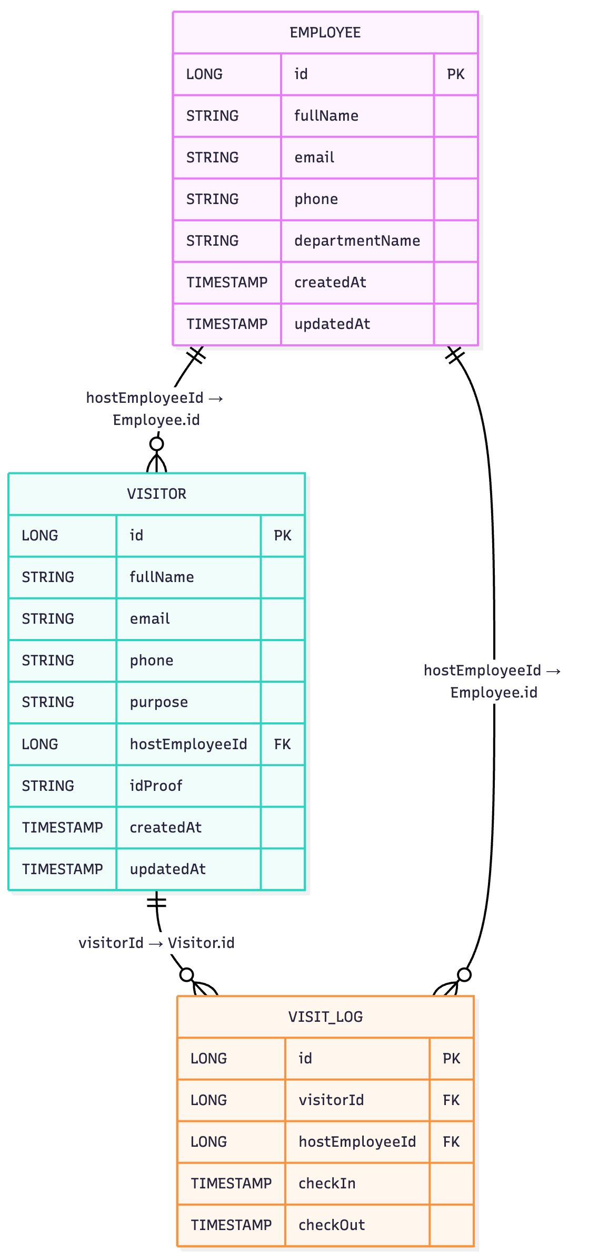
Entity Relationship Model
Core Entities
Employees: Host details (name, contact, department).
Visitors: Personal info, purpose, optional host.
VisitLogs: Check-in/check-out records linking visitors and hosts.
Relationships
Visitor → VisitLog: One visitor can have many visit entries.
Employee → VisitLog: Each visit is hosted by one employee.
Employee → Visitor: Visitors may have an assigned host.
Foreign Keys: All links enforced through IDs in VisitLogs and Visitors.

Slide 9

System Benefits
100%
3
0
Automation
Teams Coordinated
Manual Tracking
Fully automated visitor lifecycle from entry to exit
Eliminates paper logs and manual notification processes
Seamless communication across host, IT, and security
Real-Time Communication
Complete Audit Trail
Every visitor interaction is logged with timestamps, creating comprehensive records for compliance, security audits, and incident investigation.
Instant notifications ensure all stakeholders are informed immediately when visitors arrive or depart, improving security and host preparedness.

Slide 10
Suggested Improvements
Event Deduplication
Security Hardening
Add eventId to messages to prevent duplicate processing and ensure idempotent operations
Secure Kafka with TLS encryption and SASL authentication for production environments
Outbox Pattern
Observability
Implement transactional outbox for reliable event delivery and consistency guarantees
Add Prometheus monitoring with custom metrics and Grafana dashboards
Template Management
Resilience & DevOps
Move email templates to separate HTML files for easier maintenance and version control
Add retry logic with Dead Letter Queue (DLQ), improve test coverage, enhance Dockerfiles, and establish CI/CD pipeline

Slide 11

Thank You
Visitor Management System | Event-Driven Microservices Architecture
Prepared by: Onkar Vallal

